Slide 1
Supporting Your Health and Well-Being at UC
Counseling and Psychological Services,
Student Wellness Center, CARE Team, & Ombuds
Notes:
What is health and wellbeing?
Health is a state of complete physical, mental and social well-being (World Health Organization)
Well-being allows individuals to live their highest potential and develop meaning and purpose (ACHA)
At UC, we support your Health and Well-being!
When you are in need of support contact us...
Counseling and Psychological Services (CAPS)
CARE Team
Student Wellness Center
Ombuds Office
We ensure the health and well-being of students at UC

Slide 2
Counseling & Psychological Services (CAPS)

Slide 3
Counseling & psychological services
STUDENT AFFAIRS
CAPS offers a range of services that are FREE including:
Individual and Group Therapy
Power-based and Identity-based Trauma Support Services
Care Management Services
Crisis Services
Psychological Assessment Services are available by referral and are fee for service
Walk-in crisis services are available Monday-Friday, 8:00a-5:00p at our 225 Calhoun location
CALL us for an appointment
513-556-0648
Notes:
Crisis Service:
Walk-in crisis services are available Monday-Friday, 8:00a-5:00p at our 225 Calhoun location.
Crisis phone support is also available 24/7 by dialing (513) 556-0648.
Those concerned about a student can also contact CAPS by phone to receive support and consultation.
CAPS Embedded Counselors in different colleges
College of Allied Health Sciences Christy Wolfram, IMFT, ART-BC
College of Arts & Sciences Gianluca Bruno, MA, LPCC
College-Conservatory of Music Dalziel Reliford-Stone, MA, LPCC-S
College of Design, Architecture, Art, and Design Dalziel Reliford-Stone, MA, LPCC-S
College of Education, Criminal Justice, Human Services, and Information Technology Madeleine Muller, LPCC
College of Engineering & Applied Science Amy Blankenship, LPCC-S, TRCC
College of Medicine Corbin P. Watson, M.S., LPC, NCC, CRC, CVE
James L. Winkler College of Pharmacy Christy Wolfram, IMFT, ART-BC
UC Clermont Whitney Richardson, LPPC-S, CCTP
Outreach services
Let’s Talk
Free, Confidential
Virtual appointments available to those outside of Ohio
Available at Embedded Locations
Community Wellness Groups
Talk About It Tuesdays
Through Our Roots
Programming to Campus Community
Suicide Prevention
Question, Persuade and Refer (QPR)
Additional Services and Support
Peer Support Services
Bearcat Support Network
SKY@UC
Self-Help Resources
Therapy Assistance Online (TAO)
Reach Out App

Slide 4
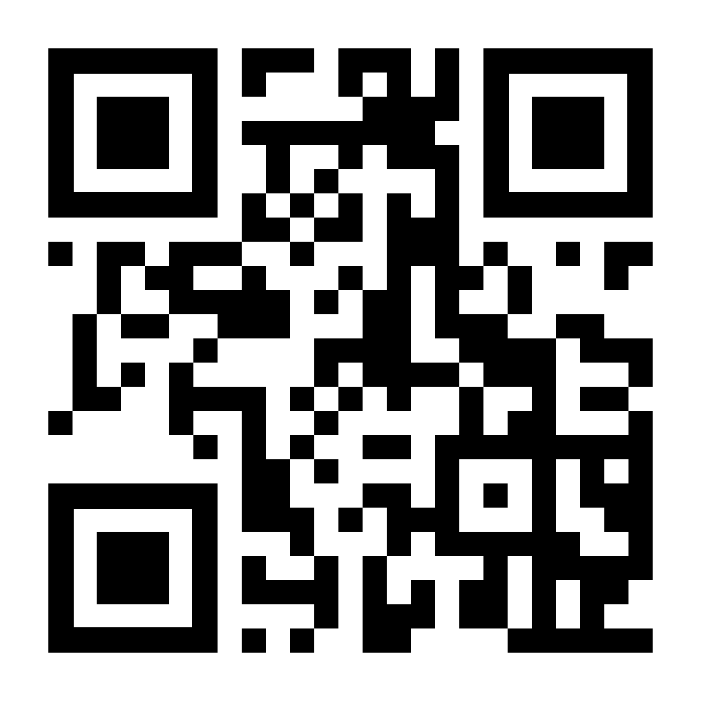
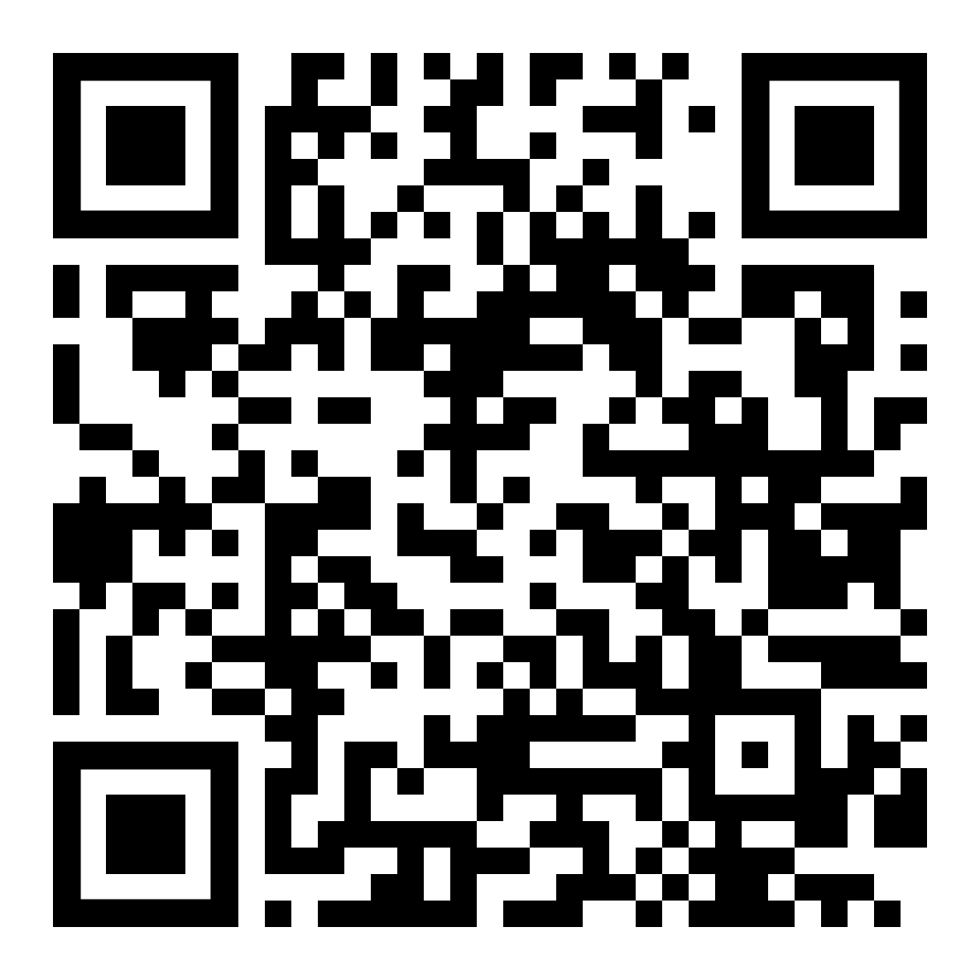
CAPS Resources
Division of Student Affairs
Peer Support
Bearcat Support Network
SKY@UC – Meditation and Yoga
Self-directed Resources
Therapy Assistance Online (TAO)
Reach Out App – Suicide Prevention Resource
BSN
Notes:
-Bearcat Support Network s a community of students that fundamentally work to destigmatize mental health while holistically working to create a network that is supportive, loving, and inclusive through peer-to-peer support groups and monthly social events.
-SKY@UC is a collaboration between SWC and CAPS in which students are offered scholarships to learn evidence-based SKY Breath Meditation, participate in Silence Retreats, and be trained to facilitate meditation and wellness workshops.
-Reach Out App: Can download for free from app store. This app includes information regarding available resources under a "Help Me" menu, tips on how to talk with others about mental health under a "Help a friend" menu, and contact information for crisis services under "Emergency Contacts".
-TAO: Therapy Assistance Online is a free app available to all UC students/faculty/staff. Register online using your UC email address. TAO is a free interactive, web-based self-help program that provides online and mobile tools to help you overcome the day-to-day challenges around stressors like anxiety, depression, or other concerns.

Slide 5
Student wellness center

Slide 6
Student wellness center overview
STUDENT AFFAIRS
The Student Wellness Center empowers students to make informed decisions regarding their health and wellness by providing evidence-based education, inclusive resources, and non-judgmental support.
Services provided:
Free health and wellness products
Presentations
Awareness events
Workshops
Notes:
Take a bearcat break at the student wellness center
We address all dimensions of wellness, including financial wellness with peer financial coaching
Get personalized feedback on how to make a budget, saving money, credit cards, and more
Sign up on GetInvolvedUC!

Slide 7
Required Online Trainings for Becoming a Bearcat!
STUDENT AFFAIRS
At UC, we build a community that cares. We provide education on how to be a responsible citizen in our community.
AlcoholEdu, Sexual Assault Prevention, Mental Well-Being, & Hazing Prevention
All students who plan to join a student organization or other student group
All incoming UC students will receive 2 email invitations on August 1 or later (depending when you register for classes)
From Vector Solutions
Check your UC email
Prevention.Training@uc.edu
Notes:
This includes organizations like fraternities and sororities, marching band, athletics, club sports, and more.

Slide 8
c.a.r.e. team

Slide 9
c.a.r.e. team
STUDENT AFFAIRS
C = Crisis
A = Assessment
R = Response
E = Evaluation
The CARE Team responds to reports about students experiencing difficulties or whose behavior is raising concerns within the University community. The team's responsibilities include gathering and sharing information, discerning concerns about a student within a setting or across multiple settings, and managing situations that encompass a variety of issues. The committee is charged to devise a coordinated plan for assessment, intervention, and management of the concerns for the students well-being and that of the University community.
If you would like additional information regarding the CARE Team, feel free to contact the Associate Dean of Students, Daniel S. Cummins at Daniel.cummins@uc.edu
Notes:
Provides advocacy and support to students who are showing signs of distress
Provides advocacy and support to student with temporary injuries
Assist students with may need to exercise a Medical Leave of Absence from their studies
Team Members:
The CARE Team is chaired by the Associate Dean of Students and composed of representatives from Academic Excellence & Support Services,
Accessibility Resources, the University of Cincinnati Police Department, Student Conduct & Community Standards, University Ombuds, Resident
Education & Development, Counseling & Psychological Services (CAPS), and a faculty representative per recommendation from Faculty Senate.
Who Should Be Referred, When & Who Can Make a Referral?
Students, faculty, staff, member of the university community, or any family/friends who interacts with students are in active positions to observe students whose behaviors may demonstrate distress affecting their overall well-being. Students should be referred if they show signs of potential threat of harm to self or others, or if they show signs of academic distress, emotional distress, or homelessness. Students should be referred as soon as these signs are recognized.
Contact:
If you would like additional information regarding the CARE Team, feel free to contact the Associate Dean of Students, Daniel S. Cummins at Daniel.cummins@uc.edu

Slide 10
ombuds

Slide 11
ombuds
STUDENT AFFAIRS
The Office of the University Ombuds is a safe place for all members (student, staff, and faculty) of the UC community to talk about university related conflicts, issues or concerns.
Our office staff will listen to your concerns and help you identify options for successful resolution. The Ombuds Office is an informal, impartial, and confidential office outside of Title IX.
If you find yourself wondering about what to do with a conflict or problem reach out and we can help with coaching through the issue, help with referrals, mediation, direct you to the formal policy, or other relevant options.
Reach out to ombuds@uc.edu or 513-556-5956
Notes:
Informal, impartial, confidential resource

Slide 12
Notes:
Go to Kahoot.com
Wellness.center@uc.edu
Wellness10

Slide 13
Resources/Contact Information
STUDENT AFFAIRS
Counseling & Psychological Services (CAPS)
225 Calhoun Street, Suite 200
www.uc.edu/campus-life/caps 513-556-0648
@UC_CAPS (Instagram & Twitter)
Student Wellness Center
480 Steger Student Life Center
Wellness.Center@uc.edu
513-556-6124
@UC_Wellness (Instagram, Twitter, Facebook)
CARE Team
Daniel.cummins@uc.edu
UCCareteam@ucmail.uc.edu 513-556-6835 and www.uc.edu/sa
Ombuds Office
ombuds@uc.edu
513-556-5956
@ombuds.uc (instagram)

Slide 14
Thank you!
Questions?

Slide 15
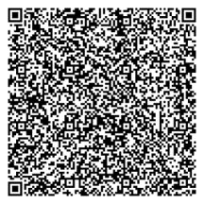
Concurrent Session Block 1
Please scan the QR code using your phone's camera to be entered into the Closing Ceremony raffle.
*must be present at Closing Ceremony to win

Slide 16
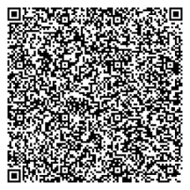
Concurrent Session Block 2
Please scan the QR code using your phone's camera to be entered into the Closing Ceremony raffle.
*must be present at Closing Ceremony to win

Slide 17
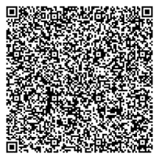
Concurrent Session Block 3
Please scan the QR code using your phone's camera to be entered into the Closing Ceremony raffle.
*must be present at Closing Ceremony to win

