Slide 1
BEARCATS BOUND
ORIENTATION
2023
COMMUTER SUCCESS

Slide 2
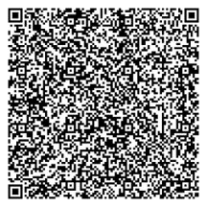
Concurrent Session Block 1
Please scan the QR code using your phone's camera to be entered into the Closing Ceremony raffle.
*must be present at Closing Ceremony to win

Slide 3
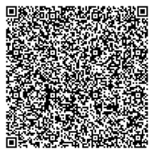
Concurrent Session Block 3
Please scan the QR code using your phone's camera to be entered into the Closing Ceremony raffle.
*must be present at Closing Ceremony to win

Slide 4
Today's Agenda
Commuter Necessities
Parking & Meal Plans
Academic Achievement
Academic Resources
Social Life
Campus Involvement
Job Opportunities

Slide 5
Commuter
Necessity:
Parking Services

Slide 6
Commuter Necessity:
Getting to Campus 101
Traffic Routes & Routines: https://www.ceas3.uc.edu/digitalSign/traffic/
Email/Emergency Alerts:
Available to Enable on Catalyst

Slide 7
Commuter Necessity: Meal Plan Options

Slide 8
Academic Achievement Support
Utilize your Academic Advisor!
Learning Commons for academic support
Pre-Professional Advising Center (PPAC)
Join a community and take advantage of it!

Slide 9
Academic Resources
Catalyst, Canopy, Canvas
Study Spots on Campus
Langsam Library
College Libraries
Tangeman University Center
Starbucks
Office Hours
Study Groups
SI Sessions

Slide 10
Bearcats
Welcome
Events will be shared on GetInvolvedUC as well as on the Corq app. The schedule will be posted in late June 2023.
GetInvolvedUC

Slide 11
Social Life
University Events
Concerts
Athletic events
CCM performances
UC Dance Marathon
Sigma Sigma Carnival
Make friends living on campus!

Slide 12
Job Opportunities
Jobs are a great way to get to know campus and meet new people!
On campus jobs can be found at jobs.uc.edu
Handshake is a career platform used by UC.
Apply to become Student Orientation Leader!
Visit the Resource Spotlight for more information.

Slide 13
Questions?

