Slide 1
Get involved, Bearcats!
Bearcats bound Orientation 2023
Student Affairs
ucinvolvment@uc.edu
Notes:
Hello! My name is (name), I use (pronouns) pronouns and I serve as (role, department). I am excited to talk with you today about how to make the most of your Bearcat experience by getting involved in one of the many opportunities available to you here at UC!

Slide 2
Student Affairs
Explore Research
Go Bearcats!
Student Organizations
Community Service
Undergraduate research opportunities are available for all fields of study
Share your Bearcat Pride by cheering on one of our 16 Division 1 athletic teams
Join one of over 800 registered student organizations here at UC
Volunteer in the community and develop your skills while making and impact
Notes:
There are many ways to get involved on campus. Explore research opportunities within your major; share your Bearcat pride by cheering on one of our 16 Division 1 athletic teams; join one of over 800 student organizations, volunteer in the community…

Slide 3
Student Affairs
Fraternities and Sororities
Competitive Organizations
Step into Leadership
Cultural Experiences
Join a fraternity or sorority and find a home away from home where you can thrive
Compete in a club sport, academic intercollegiate organization, or E-Sport
Get active in your college tribunal, hall government, or student government
Take part in events that showcase cultures across the globe, or study abroad
Notes:
You can also join a fraternity or sorority, compete in a club sport, find leadership roles, participate in cultural events on campus, and much more!

Slide 4
Student Affairs
Find Organizations
Use GetInvolvedUC to discover campus events and student organizations that may be of interest to you.
Visit getinvolved.uc.edu to get started.
Attend Events, Keep Track
Whether it's free food or friendships that you're after (or both!) find out what’s happening on campus through GetInvolvedUC.
Download the Corq app as a guide.
Notes:
Start exploring your options on GetInvolvedUC. Through the organization search tool, you can sort by various branches like competitive organizations or fraternities and sororities and explore specific categories like clubs relating to specific colleges, religious organizations, and much more.​
​
***Kristin-Do we need to add a QR code to link them to GetInvolvedUC?

Slide 5
How will you get involved?
Student Affairs
Narrow down your options
UC has a lot to offer. You can focus on active involvement, learning, and personal growth.
Something you’d like to continue
Something new to try
Something that compliments your major or builds professional skills or network
Two students working on a project.
Notes:
When deciding how to get involved, it can be hard to narrow down the options. We would encourage you to think about focusing on involvement in which you can be actively engaged and that you are able to learn from. Think through something you already do that you would like to continue in college. A new activity or club that you would like to try out. And something related to your major or that will help you enhance a skill that you will need after college. ​
​
What are some of the organizations that you are interested in learning more about at UC?​
(take some answers from the audience. Feel free to share more details about some of the interests of the group)

Slide 6
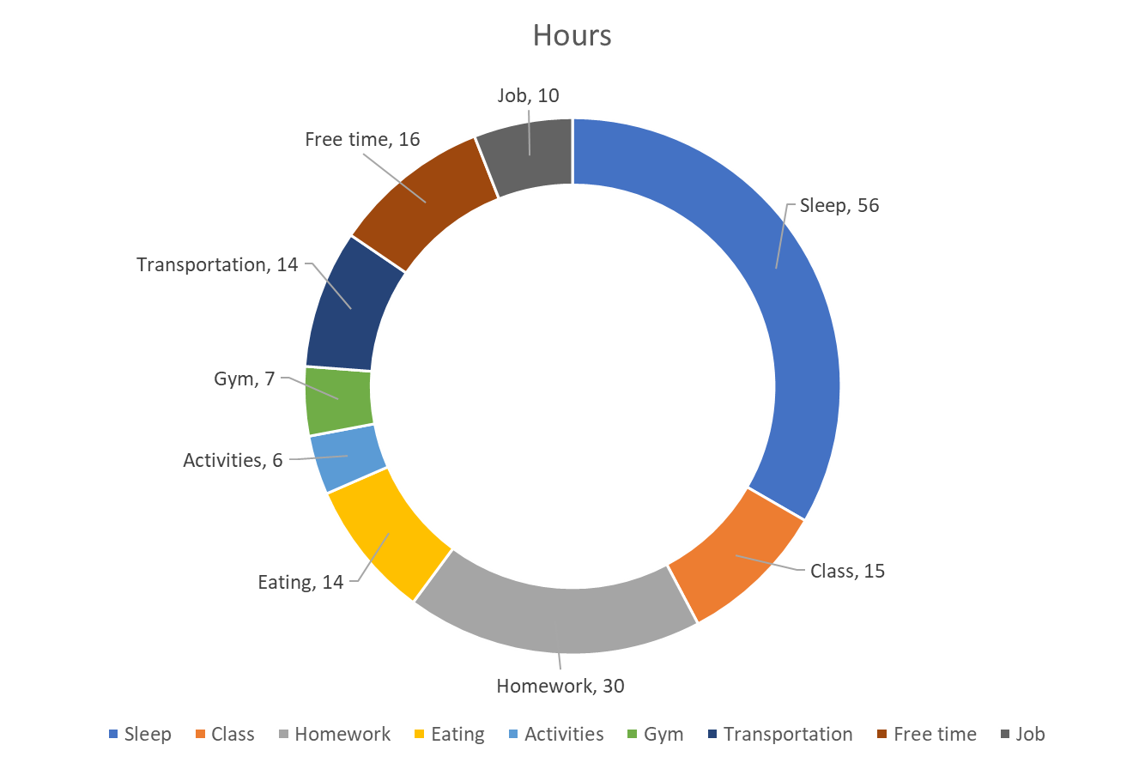
Time Management
STUDENT AFFAIRS
Notes:
As you prepare for college, we know that your schedule will look different from when you were in high school and it can be difficult to think about how to fit everything in. Let's look at a typical week and see how you may spend your time. Obviously, we know you are here to be students first so let's consider that you are taking 15 credit hours. Based on recommendations that you are spending 2 hours per credit hour outside of class doing homework, we will add in 30 hours of homework. We know that it is important to prioritize sleep so we will add 56 hours of sleep to get those 8 hours a day. Some of you may work on campus, so we will add in a 10 hour a week on-campus job. We will add in a few hours a day to make sure you are eating some good meals with friends in our dining halls and consider you get about an hour of physical activity a day. We know it takes time to get all of these places, so we will add in some transportation time.
So if you are involved in 3 activities, we may consider about two hours a week per activity. This still leaves more than 2 hours a day for totally unstructured time to relax, connect with friends, or do whatever you need to be your best self on campus.

Slide 7
Student Affairs
Find opportunities, track hours
Connect with local nonprofits and find hundreds of volunteer opportunities, track and report your service hours for scholarships.
Visit volunteer.uc.edu to get started.
Do something you care about
For example, Bearcat Buddies connects UC students to children in Cincinnati Public Schools through tutoring relationships.
Visit uc.edu/cce to get started.
Notes:
There are offices and centers across the university that are here to help you achieve your goals and make the most of your Bearcat experience. The Center for Community Engagement helps students get involved in our wider community, and achieve their goals related to community service. If you have a scholarship that requires community service, if you are in a class or program that incentivizes community service, or if you just want to make a difference in our community—the Center for Community Engagement is here to help. From neighborhood cleanups to commitments like the Bearcat Buddies tutoring program that connects UC students to children in Cincinnati public schools, there is something for everyone. We know you have something to offer, why not share it beyond UC? You can log into volunteer.uc.edu with your UC username and password to start looking for opportunities that meet your interests and schedule.

Slide 8
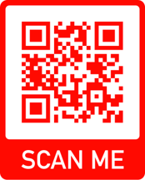
Are you registered to vote?
Student Affairs
Get involved in Democracy
UC partners with TurboVote to help students participate in democracy. Visit uc.turbovote.org to:
Check your voter registration status
Register to vote
Get election reminders, and more
Two students asking peers “Why are you voting?”
Notes:
Part of the University of Cincinnati’s mission is to “develop educated and engaged citizens.” UC Votes encourages all members of our Bearcat community to exercise their right to vote, and provides resources like TurboVote to help you along the way. Visit uc.turbovote.org to get assistance with your electoral engagement. Through TurboVote, you can check your voter registration status, register to vote, get election reminders, and more.

Slide 9
Bearcats Welcome & First Year Bearcat Kickoff
Student Affairs
Save the Date! August 15 – September 8
Bearcats Welcome features tons of events, from social to educational, and from optional to required. Don’t miss out on all the fun.
Events will be shared on GetInvolvedUC and CORQ
First Year Bearcat Kickoff is the official welcome into the University of Cincinnati community for all first time Bearcats. First Year Bearcat Kickoff will be on Thursday, August 17th.
Attend College day on Friday, August 18th!
A student helping three new Bearcat students find student organizations at the involvement fair during Bearcats Welcome.
Notes:
As you embark on this new experience as a Bearcat, we hope your first few weeks on campus set the stage for your college career. We hope you are just as excited to be at UC as we are to have you here!
College Day 2023 is Friday, August 18th!
This is a required event for all first-year students!
College Day is an opportunity for you to meet classmates within your specific college, meet faculty, administrators, and your academic advisor, as well as learn the expectations that your college has of you!

Slide 10
Fraternity and Sorority Recruitment and Intake
Student Affairs
Follow @uc_FSL
Opportunities to learn more are right around the corner.
College Panhellenic Council recruitment registration ends August 13
Fraternity and Sorority Life Festival on August 25
Interfraternity Council info session on August 28
National Pan-Hellenic Council “Declassified” on August 30
Multicultural Greek Council “Meeting the Greeks” on August 31
Fraternity and sorority members representing their organizations.
Notes:
If you are interested in joining a fraternity or sorority there are lots of ways to get more information and get involved. Registration for our College Panhellenic Council formal recruitment is open now through August 13th. CPC represents our 11 traditionally housed sororities. Meet all of our chapters at the FSL festival on August 25th. Our traditionally housed Interfraternity Council chapters will be hosting an information session on August 28th. Our historically Black fraternities and sororities in the National Panhellenic Council will be hosing their Declassified information session on August 30th. And our Latinx and Asian interest fraternities and sororities in our Multicultural Greek Council will be hosting Meet the Greeks on August 31. Follow @uc_fsl to stay up to date with all information.

Slide 11
Student Affairs
Prevention Trainings
getinvolved.uc.edu
Bearcats Welcome
Involvement Fair
See your Catalyst checklist to access the four required virtual prevention trainings
Check out GetInvolvedUC or the Corq app to explore organizations and events
Look for Bearcats Welcome events to connect with campus and your peers
You won’t want to miss the student involvement fair and all that comes with it!
Notes:
As you prepare to come to campus, here are a few reminders to make sure you are ready to get involved.
Please make sure you complete your 4 virtual prevention trainings through the Vector Solutions platform prior to coming to campus. These trainings are required prior to joining any student organization.
Update your profile on GetInvolvedUC
Save the Date for Bearcats Welcome and the Student Involvement Fair

Slide 12
THANK YOU
Questions?
ucinvolvement@uc.edu
Notes:
Take questions and encourage use of involvement email for specific questions

