Slide 1
Parent & Family Programs
Your family’s home at UC
Whitney White, MS
Director
Dy’Mand Montgomery, MEd
Assistant Director
Caitlin Borges, MA
Assistant Director

Slide 2
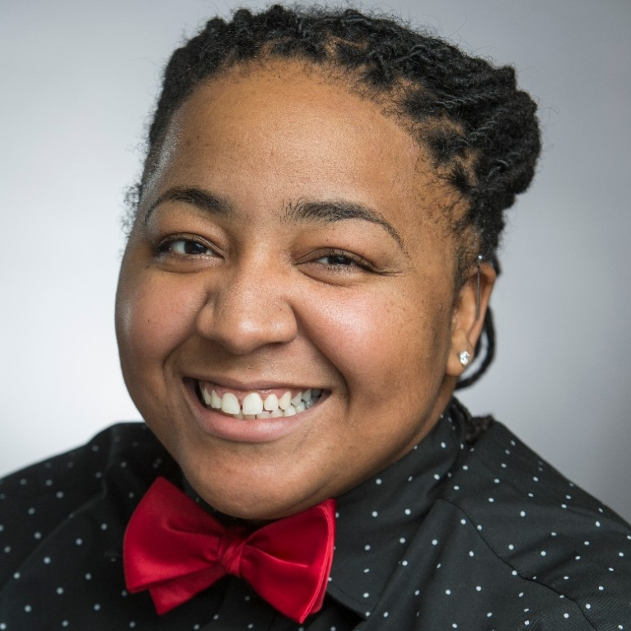
Meet Our Staff
Whitney White Director
Dy'Mand Montgomery Assistant Director of Family Engagement
Caitlin Borges Assistant Director of Communications
Notes:
DM

Slide 3
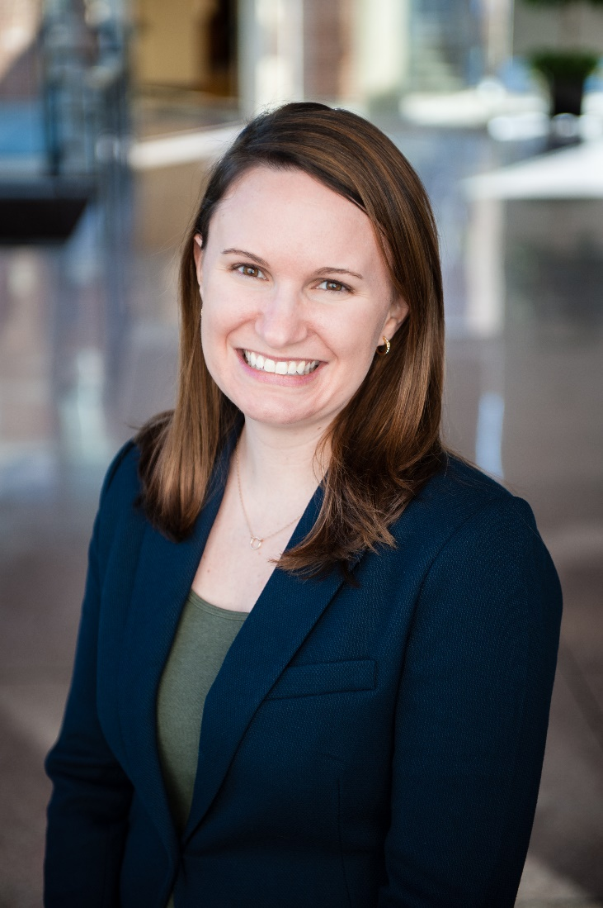
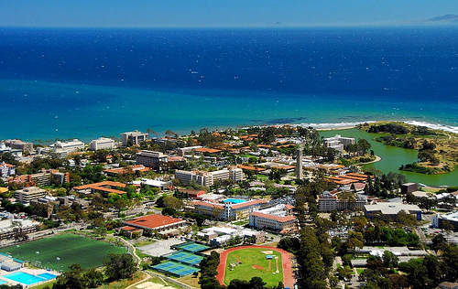
Meet Whitney
Whitney White, MS, Director

Slide 4
Meet Dy'Mand
Dy’Mand Montgomery, MEd Assistant Director of Family Engagement

Slide 5
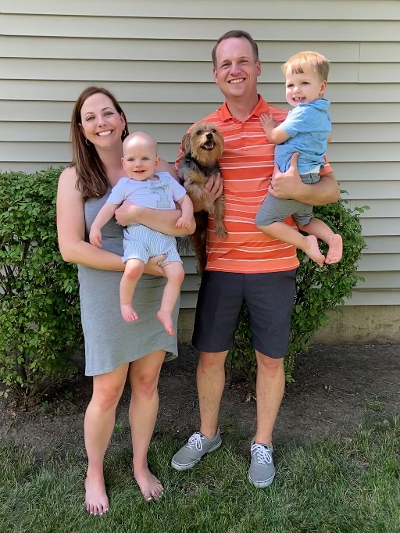
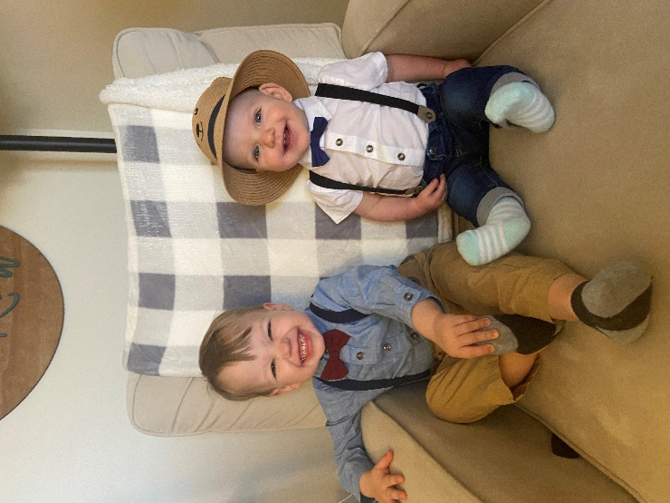
Meet Caitlin
Caitlin Borges, MA Assistant Director of Communications

Slide 6
Today's Goals
When you leave here, we want you to know:
Who we are!
How to get help and ask questions!
Where to find important information.
How to start preparing your student this summer to be successful!
Notes:
WW

Slide 7
Our Purpose
Information. Engagement. Support.
Parent & Family Programs provides families with information about student services and resources, campus engagement opportunities, and a dedicated place to receive support in helping their students successfully navigate the UC experience.
Notes:
Dedicated place to receive support
Just for you
Support you in supporting/guiding your student
Knowing when to get involved
Information about student services and resources
- Regular communication and useful tools to help you support your student and become an informed partner
Campus engagement opportunities
Give you the chance to get to know fellow families and our campus
Helping you and your student successfully navigate the UC experience

Slide 8
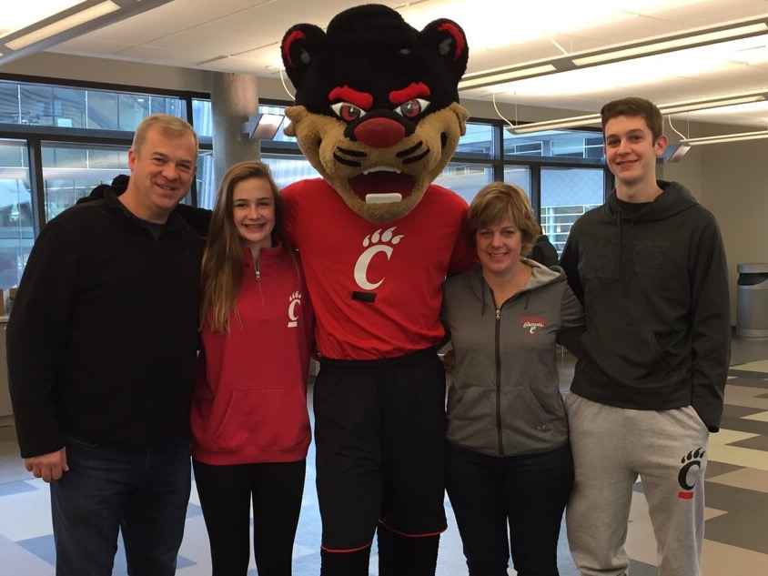
Support
Dedicated phone and email support
families@uc.edu 513-556-1200
Notes:
DM

Slide 9
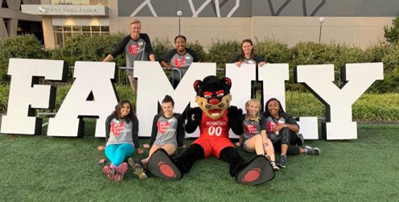
Information
Family Portal – uc.campusesp.com
Website – uc.edu/families
Instagram - @UCBearcatFamilies
Notes:
Family Portal – Log in anytime or wait for the Monthly newsletter of timely content – events on campus, what’s happening for your student during that time of the semester, etc.
Social Media – Follow us on Facebook for timely reminders, resources for your students, and to get a glimpse into campus life.
Website – Valuable information to help you learn more about UC and the resources available for you and your student. We are consistently adding new info and updating to create a strong resource.

Slide 10
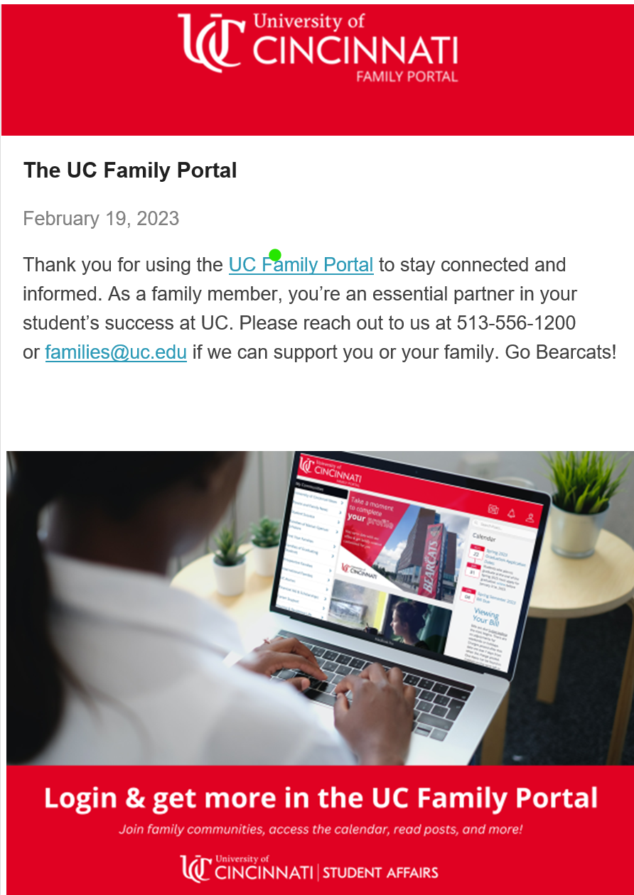
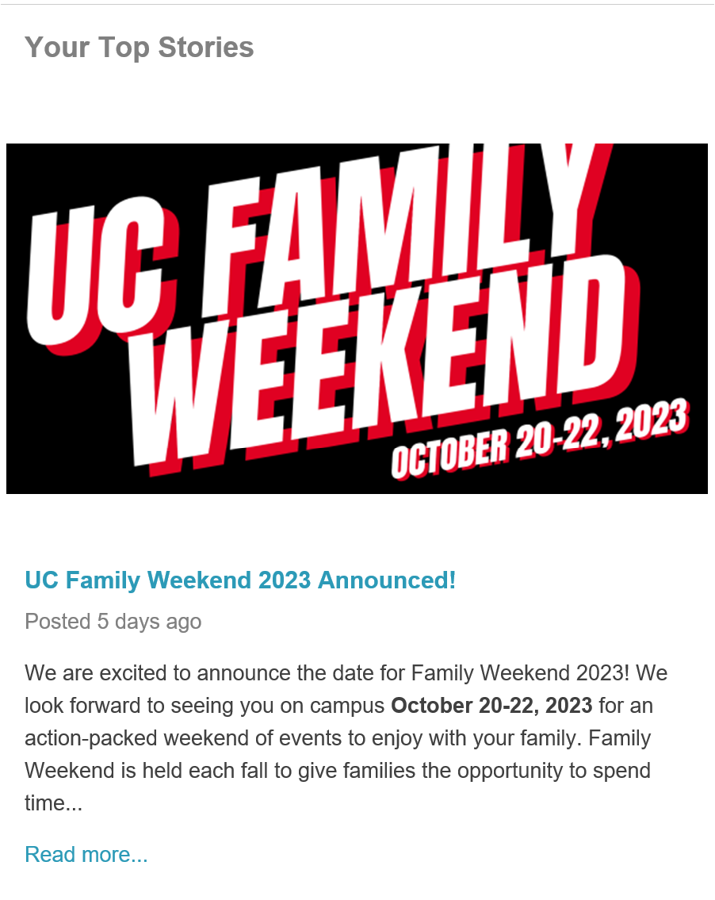
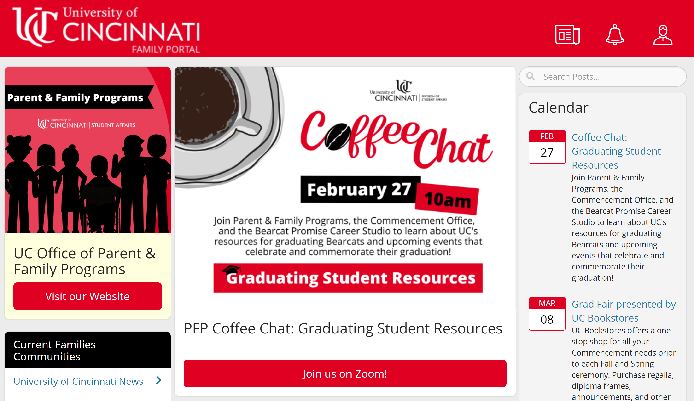
Information
Family Portal
uc.campusesp.com
Notes:
Our official form of communication
Packed full of UC Content
Generates regular email newsletters
Calendar feature
Advertisements
Users can join communities to receive customized content and engage with similar families
Registering for events

Slide 11
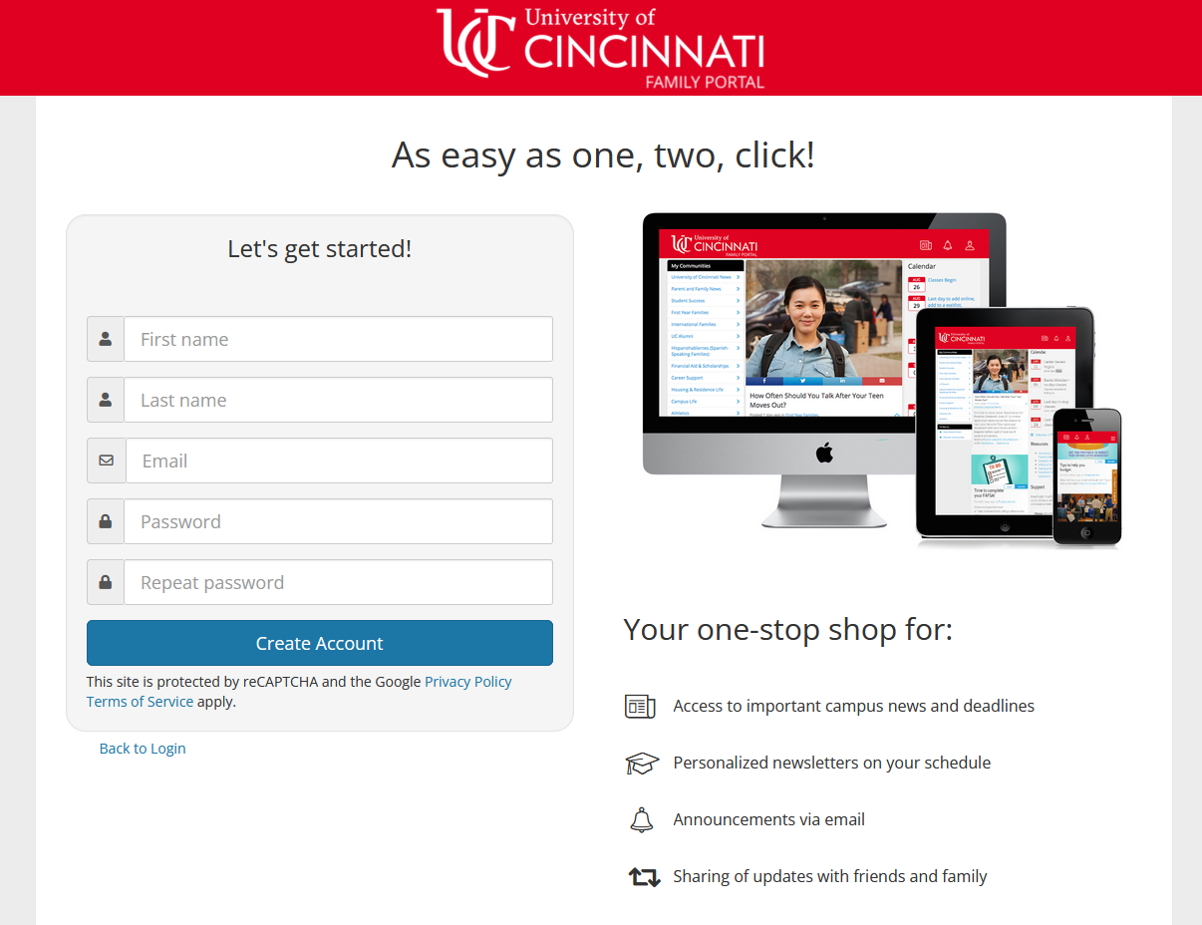
Information
Family Portal
uc.campusesp.com
Notes:
Sign up is quick!

Slide 12
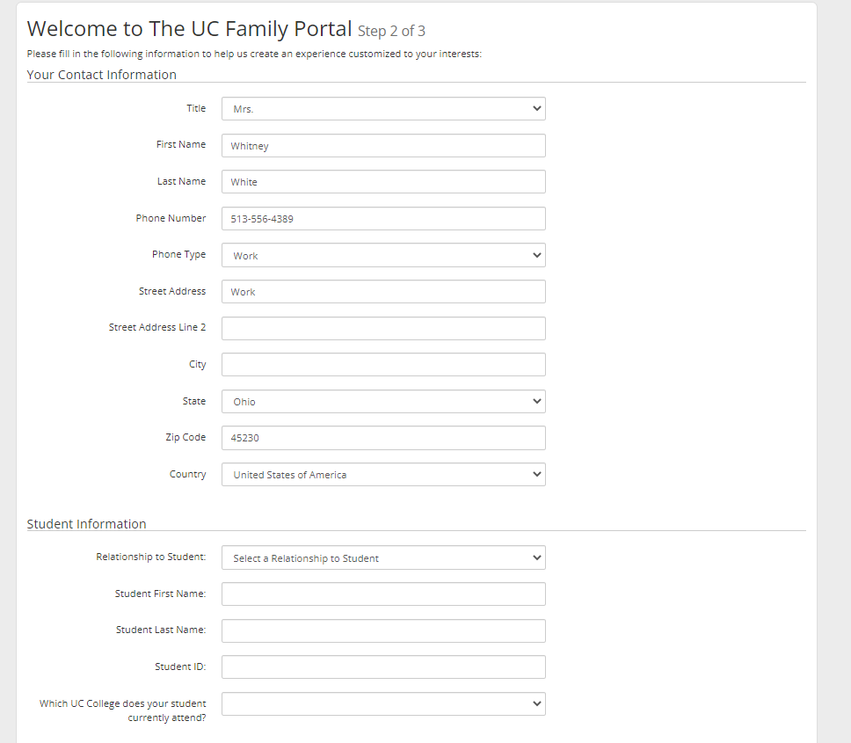
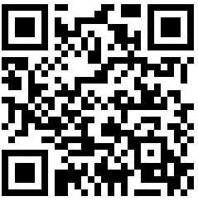
Information
Family Portal
uc.campusesp.com
Sign up here!
Notes:
Make sure to customize your profile so you get completely custom info.

Slide 13
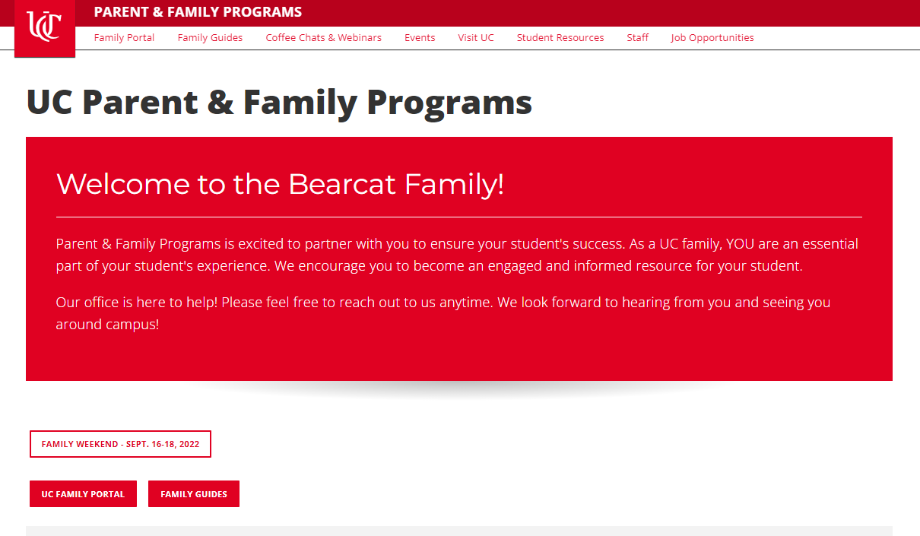
Family Guide
Independence & Transition
Money Matters
Fraternity & Sorority Life
Fitting In & Finding Friends
Alcohol & Other Drugs
Academic Success
Diversity & Inclusion
Career Exploration
Safety & Crime Prevention
Sexual Violence Prevention
Mental Health & Well-Being
Living in Community
Information
Website
uc.edu/families
Notes:
WW

Slide 14
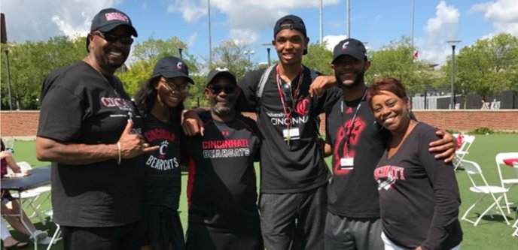
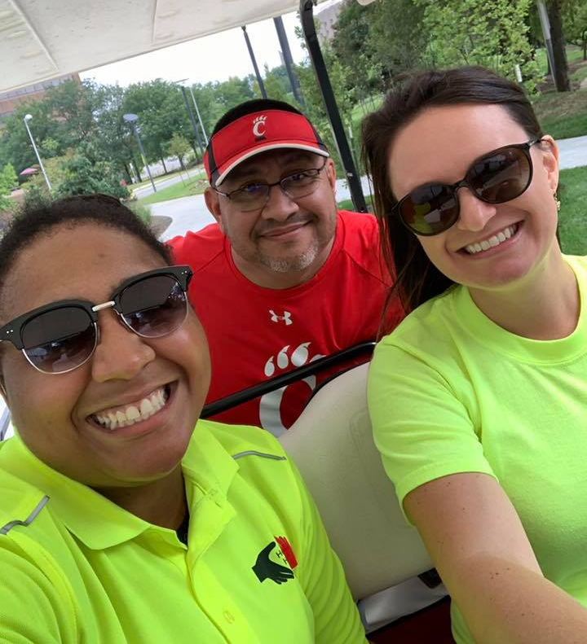
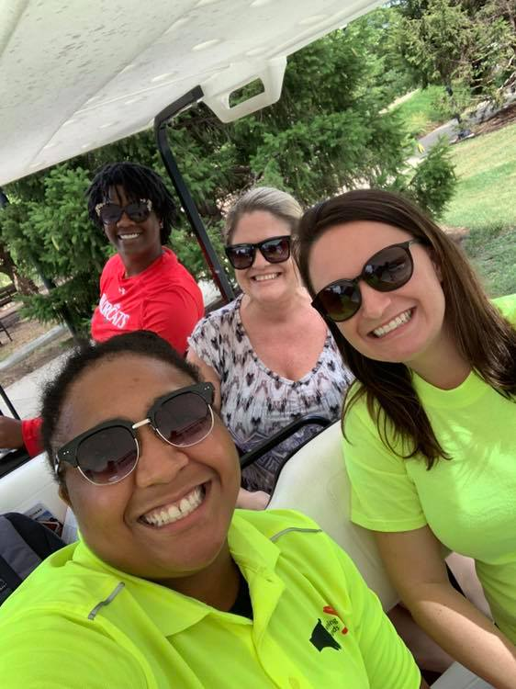
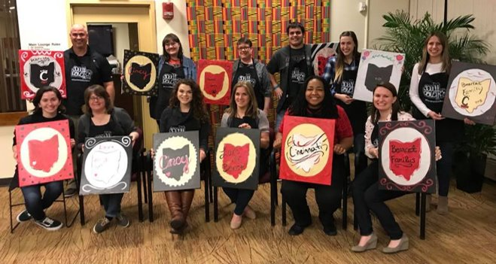
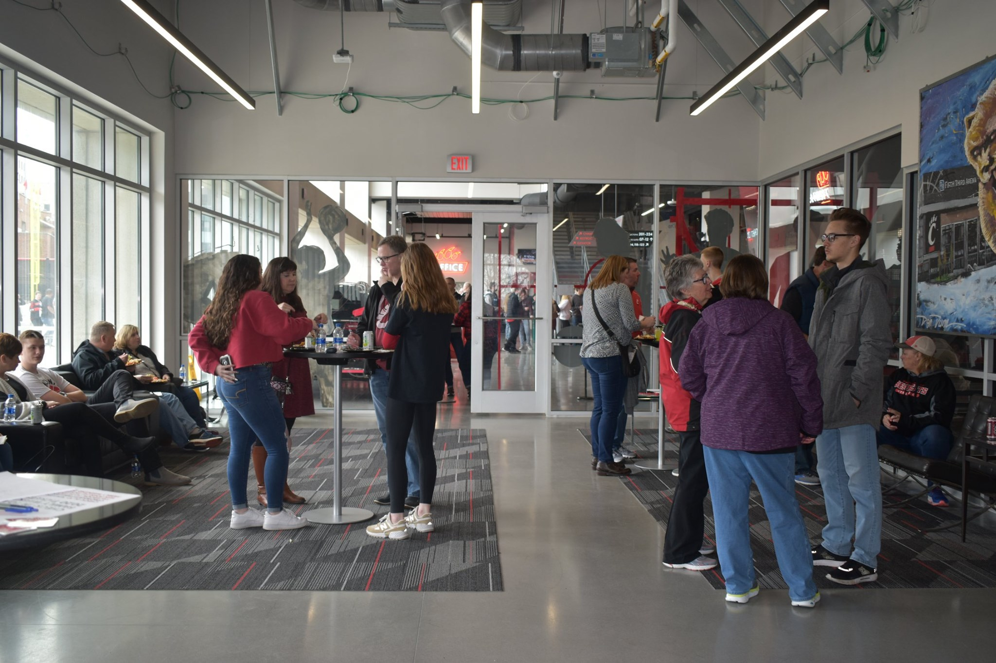
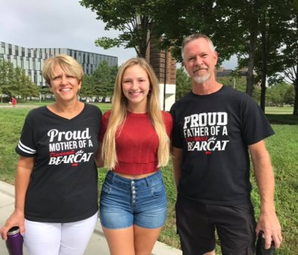
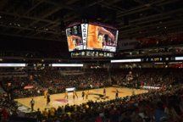
Signature Programs
Engagement: Opportunities on-campus, virtually, and beyond.
Move-In: Golf Cart Karaoke
Letters to + from Home
Spring Sporting Event
Commencement Family Fun Zone
Care Packages
Virtual Coffee Chats/Webinars
Notes:
DM

Slide 15
Engagement
Care Packages
Connecting with Your Bearcat:
You can order Care Packages thru our office *Limited availability
Care packages will include an assortment of snacks + an Exclusive UC Gift!
Order includes TWO Final Exam Packages (Fall & Spring)
Cost $80
Notes:
DM

Slide 16
Coffee Chats
Upcoming:
Advising
Transitioning to Post-Secondary for Students with Disabilities
Getting Involved (Fall)

Slide 17
Engagement
Family Weekend – Save the Date!
Notes:
DM

Slide 18
Engagement
Family Weekend
Notes:
DM

Slide 19
Our Purpose
Information. Engagement. Support.
Parent & Family Programs provides families with information about student services and resources, campus engagement opportunities, and a dedicated place to receive support in helping their students successfully navigate the UC experience.
Notes:
WW

Slide 20
Today’s College Student
Entrepreneurial
Innovators
Loyal
Less Self-Sufficient
Diverse
Achievers
Confident
Parental Involvement
Generation Z
Dependent
Social Justice
Structured Life
Environmental Awareness
Multi-taskers
Digital Natives
Open-Minded
Social Media
Diverse Family Structures
Notes:
Generational research makes generalizations, but you can see some trends we see among Gen Z.
These types of characteristics inform how they navigate and approach their college experience.
This generation is incredible (innovative, committed to SJ/environment/etc., high achieving), but they also have had a lot of family involvement along the way. Less opportunities to be independent, manage their own schedule, etc.
Each student’s experience will be unique. One solution does not fit all.

Slide 21
College is Complex
Finding Community
Building their Resume
Time Management
Pressure to Succeed
Financial Aid
Finding the Right Major
Peer Pressure
Budgeting
Parental Involvement
Arranging Testing Accommodations
Adjusting to College Classes
Financial Impact at Home
Working?
Managing Health
Homesickness
FERPA
Social Media
Tuition and Fees
Alcohol & Drugs
Living with a Roommate
Finding Friends
Expected to be an Adult
Large Campus Size
Fitting In
Exploring Identity
Finding Someone Who Looks Like Me
Family Relationships
Balancing Home and School
Diversity & Inclusion
Trying on a New Self
Friends Back Home
Notes:
College brings about a lot of new challenges and experiences. Your student will not experience all of these and certainly not at once. But, the qualities of Gen Z we just looked at can inform how they react and how they manage these types of new experiences.
This is where our office comes in. We know that when your student encounters one of these challenges, they will most likely turn to their family first. We want you to be a knowledgeable and informed resources to help you student. So, we are here to support you.

Slide 22
Common Issues in the 1st Year
1st Year
Academics
Money Matters
Independence & Transition
Finding a Community
External Factors
Notes:
So let’s start the conversation today and talk about some of these typical challenges and opportunities for growth.
We’re going to work through this circle and talk through some things that arise around the academic experience, money and finances, student independence, finding a community, and navigating outside obligations.

Slide 23
Academics
Academics
Major & Career Exploration
Time Management
Pressure to Succeed
Students with Disabilities
Adjusting to College Level Courses
Page 9
Notes:
Major changing
Major=career can be a myth
It’s their major and it’s important for them to go through the process of finding their right fit.
Time management – give them opportunities to practice this summer.
Pressure to succeed can yield cheating, drug use, etc. to promote success. Set realistic expectations. Express pride. Show support and acceptance.
Classes will require them to think critically and differently than high school did. May get a lower grade for the same level of work.
Students with disabilities: a new process compared to high school. Student must take initiative to establish accommodations and to communicate to their faculty.

Slide 24
Money Matters
Money Matters
Tuition and Fees
Working
Budgeting
Credit
Financial Aid
Page 25
Notes:
Transparency and communication is key in the money matters area. Regardless of the amount of financial contribution from their family, students can make it work in a wide range of financial scenarios, but they need to know upfront and honestly about the family’s financial situation. What can the family contribute? Will they need to take out loans? Do they need to work and how much?
Tuition and fees – understanding the bill, what it costs to attend college. Look at the bill with your student. Sit down and discuss how much money they think they’ll need (sidenote: it’s not a lot, most of their expenses are covered with tuition and fees, room and board, if they are living on campus).
Working – do they need to or want to work? How much?
Budgeting – make a budget with your student. If they’ve never done it before, start this summer with something small, like their summer job earnings.
Credit – talk about the importance of maintaining a good credit score and help them understand what it is; use credit cards responsibly; paying bills on time, etc.
Financial Aid – As a family member, your information is an important part of the FA process; you’ll need to provide information about your own finances for the FAFSA each year. It’s important to make the priority deadline each year to be considered for the widest range of aid.

Slide 25
Independence & Transition
Independence & Transition
Managing time, money, health, etc.
Treated as adults
FERPA
Large campus size
Homesickness
Alcohol and drug choices/ Peer pressure
Mental Health
Page 21
Page 7
Notes:
More independence in high school yields an easier transition. Start now. Encourage opportunities to utilize problem solving skills. Resist the urge to jump in and solve it for them.
They’ll be treated as an adult at UC. They are adults and we want them to see themselves that way, as well.
FERPA: explain the law and delegated access; we encourage you to let your student take the lead here. Rather than logging in to the check their grades, ask questions like “How did you feel this semester went?” or “What was your favorite class?” which help to build a positive dialogue. Your student will feel like they can be more open and honest with you.
Large campus size – this can feel like a very large and overwhelming place depending on where you are coming from. It helps to get connected to your community, join a club, get involved in a UC program, etc. which will make it feel smaller. We’ll talk more about building community in a moment.
Homesickness – this is a very common experience and almost all students have it at least once. We encourage you to be there for your student, support them, let them know it gets easier. Encourage them to get involved and connected as this will make UC start to feel more like home. If your student is missing home, try to come visit them (or video call) if possible. This will allow them to get a taste of home without leaving UC and missing all the important “Getting connected” time that happens early on.
Alcohol and Drugs – students may be exposed to others using AOD, or may experiment for the first time. Data shows that family members are students #1 source of information and guidance on decisions like alcohol or drug use. We encourage you to talk to your student, discuss your expectations, and safer choices. They may seem like they don’t want to talk about it, but they are listening.
Managing their health – students may be managing their own health for the first time. Encourage them to take time for themselves, take a break from their classwork to focus on personal or social time. Encourage them to reach out to get help.

Slide 26
Finding a Community
Finding Community
Fitting In & Finding Friends
Social Media
Finding a New Self
Getting Involved
Living in Community
Diversity & Inclusion
Page 14
Page 11
Page 19
Notes:
Finding Friends – lots of opportunities to get engaged and build community here at UC, which will make it feel more like home. Get involved in the residence hall. Join a club or organization. Check out CampusLINK for all kinds of events and to explore student orgs.
Encourage them to case their net wide. Try out lots of different things to find the community(ies) that are right for you.
Residence halls – A new and important learning experience for most students. Might be the first time living with a roommate. Opportunity to get involved, go to events, make friends. Encourage them to be a caring, respectful roommate. They can talk to their roommate about their shared vision and expectations from the beginning to make the living arrangement work.
Finding a new self – They may try out new things. This is an important part of college, being a young adult, learning more about who you are, and exploring identity. Your meat eater may come home a vegan. Often, parents drastic changes, but it’s usually not that drastic and they often come back pretty close to who they are. But, encourage this self-exploration and try to be supportive if your Bearcat comes home with red hair.
Social media – Social media is a great resource for getting connected on campus, meeting friends (even before arriving at UC) and finding out what’s going on everyday. But, encourage them to make good choices. Have a discussion about social media, privacy, and stopping to think about how you want to portray yourself online.

Slide 27
External Factors
External Factors
Working to Support Family
Balancing Home and School
Family Support/ Lack of Family Support
Relationships at Home
Working Too Many Hours
Notes:
There are often external factors that can weigh on students while on-campus, such as responsibilities at home, working a lot of hours, or other relationships.
Many students have responsibilities at home that continue when they enter UC. This could be contributing financially or physical responsibilities, such as taking care of a sibling. Attending college is a full-time job (and more), so if it’s possible to pass those duties on to someone else, it can really help leave your Bearcat more time to fully engage with their academics and their community. If your student commutes to UC and lives at home, this also gives them the chance to stick around campus later to attend a club meeting, make friends, or meet with faculty.
Many students work to support their family and/or their college experience. As we discussed before, students can usually make it work as long as they have a realistic picture of what’s on their plate. Their advisor, academic coaches, and other staff can help them make a plan for success while working. Be sure to talk with your student about what they will need to realistically contribute to their college education and/or family.
Working, whether students need to in order to pay for college or not, is an important aspect of college. We want them to gain work experience, build their resume, and further explore career opportunities. We actually also see that students who work (around 10 hours a week) have better time management and higher grades. This is often attributed to being forced to be a little more organized to manage these additional responsibilities. However, too many hours and we start to see grades impacted negatively.
Relationships at home also can inform your student’s experience. This looks different for every student. You may have a sibling at home who is going to suddenly be the only one at home. Your relationship will change with your student. You may be feeling a wide range of emotions as you are sending them off, which is completely normal. It might feel like they aren’t as engaged at home, or they’re already acting like they’re here. But, they are feeling a wide range of emotions, too. They may have significant other at home as well. These relationships often change, even if they think they’ll be together.
Ultimately, the most important factor is family support. We partner with families and have an office dedicated to supporting you because we know that your involvement, your support, and your championing your student is one of the top – if not the top – factor in student success. We encourage you to be there for them. Listen. Help them troubleshoot. Become a knowledgeable resource. Show them you support them through the challenges and the successes.

Slide 28
Concurrent Sessions
Check your schedule for session times & locations
Supporting Your Health & Well-Being
Supporting an Inclusive & Accessible Bearcat Community
Get Involved, Bearcats!
Residence Life & Housing

Slide 29
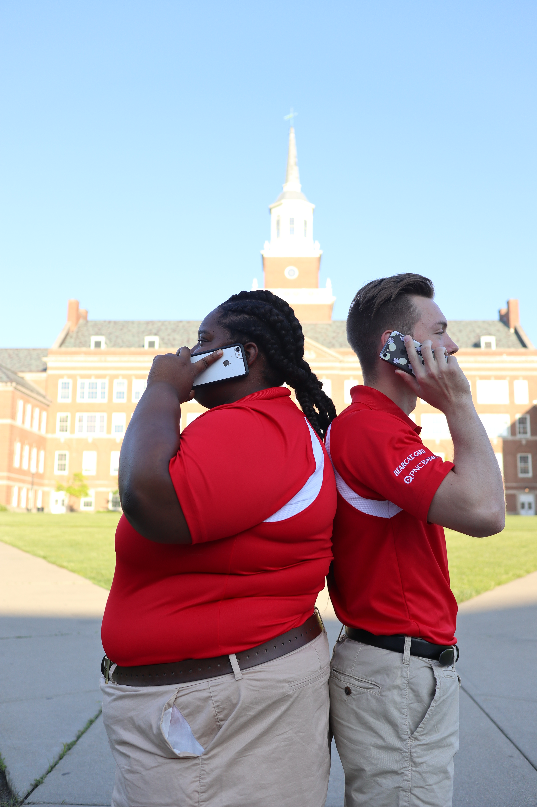
UC Family 101
Your Homework
Review the Family Guides series.
Set a communication plan.
Celebrate their successes!
Plan to visit!
Set expectations for time at home.
Notes:
Communication plan – when, how often, etc. we will talk. Convey your expectations. Be flexible. DO more than text. They get lots of emails. Packages and mail are a nice surprise no matter what they are.
Celebrate – big or small celebrate! Use a positive spin.
Visit – let them show you around. You’ll be surprised at who they are becoming and their new home at UC. Family Weekend.
When they come home, set expectations. They may run off with friends, do what they want. They’re used to managing their own time. Be upfront about what you expect.

Slide 30
UC Family 101
Your Homework
Remind your student to complete required trainings and have a conversation about what they learned!
AlcoholEDU
Anti-Hazing Training
Mental Well-Being
Sexual Assault Prevention
Partner with your student in their success.
Become a knowledgeable UC resource.
Notes:
Remind them to complete required trainings. They will get an email later this summer. Following completion, is a great time to have a conversation about what they learned and share your expectations.
Partner – they will be more open and you’ll be able to share your suggestions for navigating UC if they will you’re a partner.
Become a knowledgeable resource. Won’t be too long before they are calling.

Slide 33
We’re Here to Help
Parent & Family Programs
families@uc.edu 513-556-1200 uc.edu/families uc.campusesp.com @UCBearcatFamilies

